Slide 1
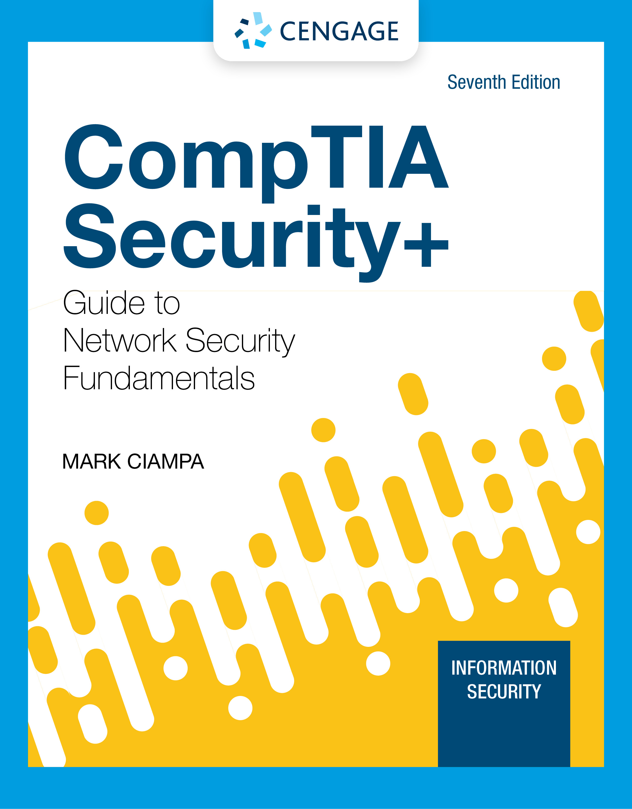
Module 9: Network Security Appliances and Technologies
CompTIA Security+ Guide
to Network Security Fundamentals, 7th Edition

Slide 2
Module Objectives
By the end of this module, you should be able to:
1. List the different types of network security appliances and how they can be used
2. Describe network security technologies

Slide 3
Security Appliances
Security can be achieved through appliances that directly address security and by using the security features in standard networking devices
Using both standard networking devices and security appliances can result in a layered security approach
Appliances include:
Firewalls
Proxy servers
Deception instruments
Intrusion detection and prevention systems
Network hardware security models

Slide 4
Firewalls (1 of 6)
To use firewalls effectively, you must understand the function of firewalls and know the different types of firewalls and specialized firewall appliances
Firewall Functions
A firewall uses bidirectional inspection to examine outgoing and incoming packets
The actions are based on specific criteria or rules (called rule-based firewalls)
A more flexible type of firewall is a policy-based firewall which allows more generic statements instead of specific rules
Firewalls can also apply content/URL filtering

Slide 5
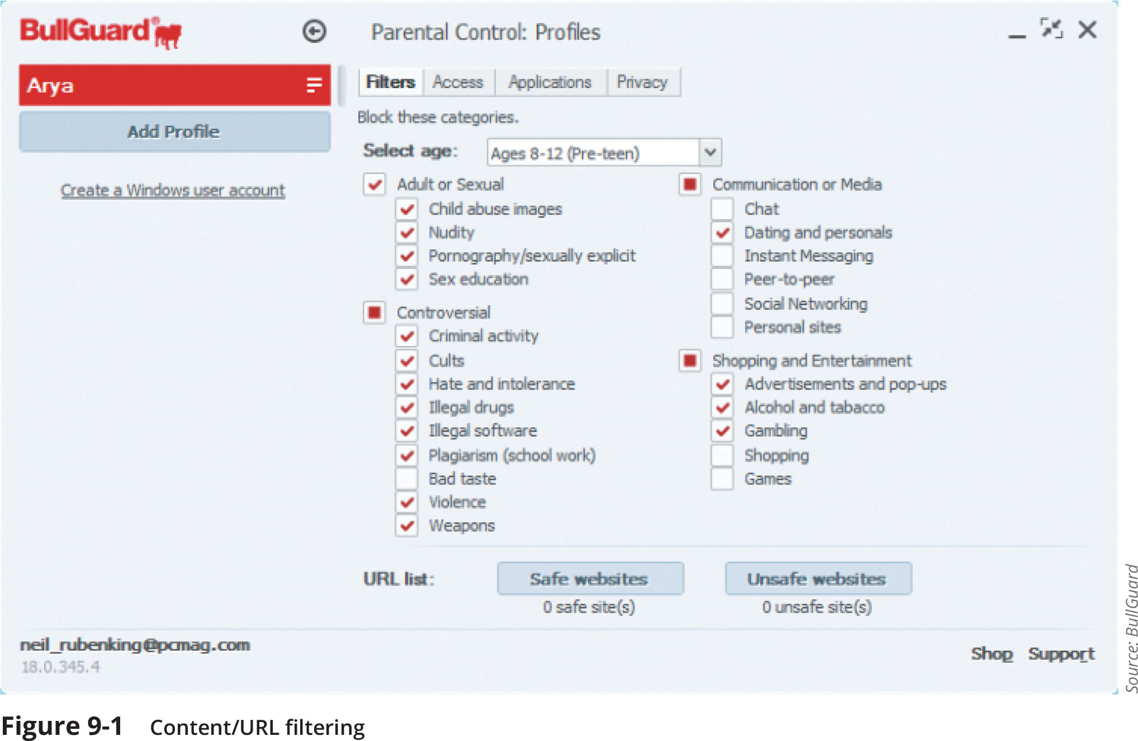
Firewalls (2 of 6)

Slide 6
Firewalls (3 of 6)
Firewall Categories
Stateful vs. stateless
Open source vs. proprietary
Hardware vs. software
Host vs. appliance vs. virtual

Slide 7
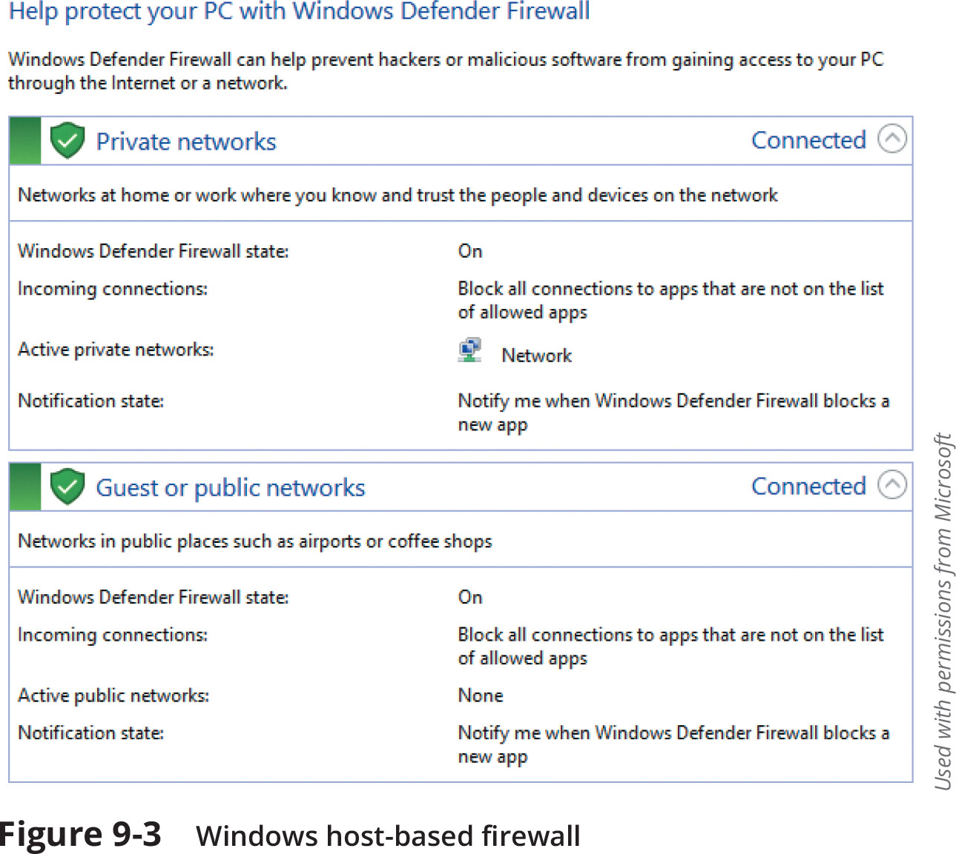
Firewalls (4 of 6)

Slide 8
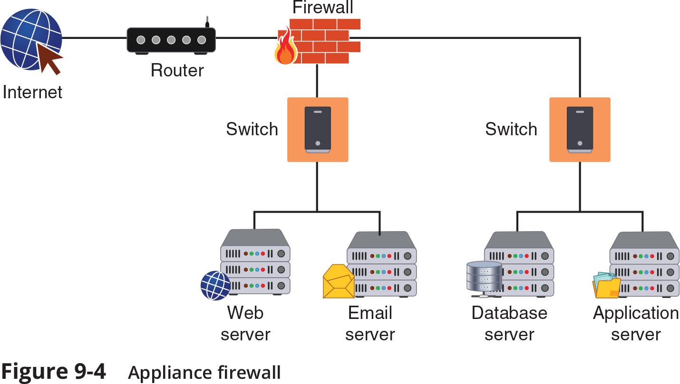
Firewalls (5 of 6)

Slide 9
Firewalls (6 of 6)
Specialized Firewall Appliances
Web application firewall
Network address translation gateway
Network address translation (NAT) is a technique that allows private IP addresses to be used on the public internet
Next generation firewall
Unified threat management (UTM)
UTM is a device that combines several security functions such as packet filtering, antispam, antiphishing, antispyware, encryption, intrusion protection, and web filtering

Slide 10
Proxy Servers (1 of 2)
Proxies are devices that act as substitutes on behalf of the primary device
A forward proxy is a computer or an application that intercepts user requests from the internal secure network and processes the requests on behalf of the user
A reverse proxy routes requests coming from an external network to the correct internal server
A proxy server can provide a degree of protection
It can look for malware by intercepting it before it reaches the internal endpoint
It can hide the IP address of endpoints inside the secure network so that only the proxy server’s IP address is used on the open Internet

Slide 11
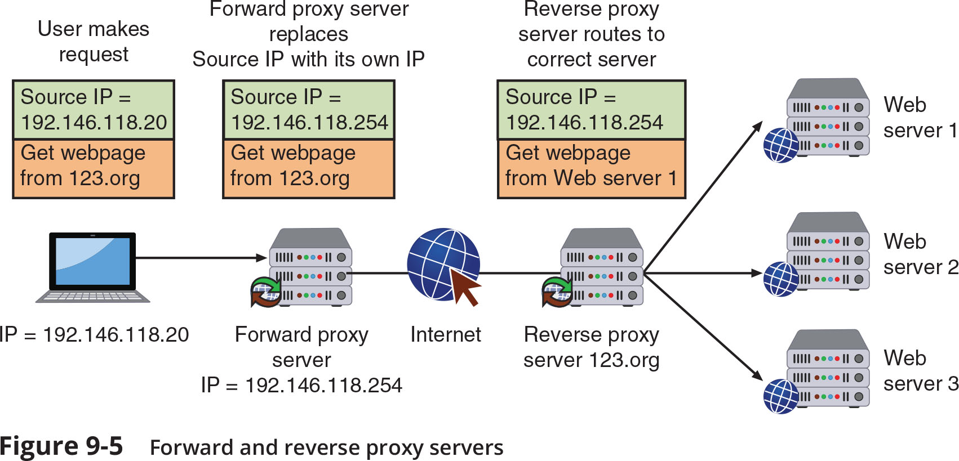
Proxy Servers (2 of 2)

Slide 12
Deception Instruments (1 of 3)
Deception can be used as a security defense
By directing threat actors away from a valuable asset to something that has little or no value
Network deception can involve creating and using honeypots and sinkholes
Honeypots
A honeypot is a computer located in an area with limited security that serves as “bait” to threat actors
Two goals of using a honeypot:
Deflect
Discover

Slide 13
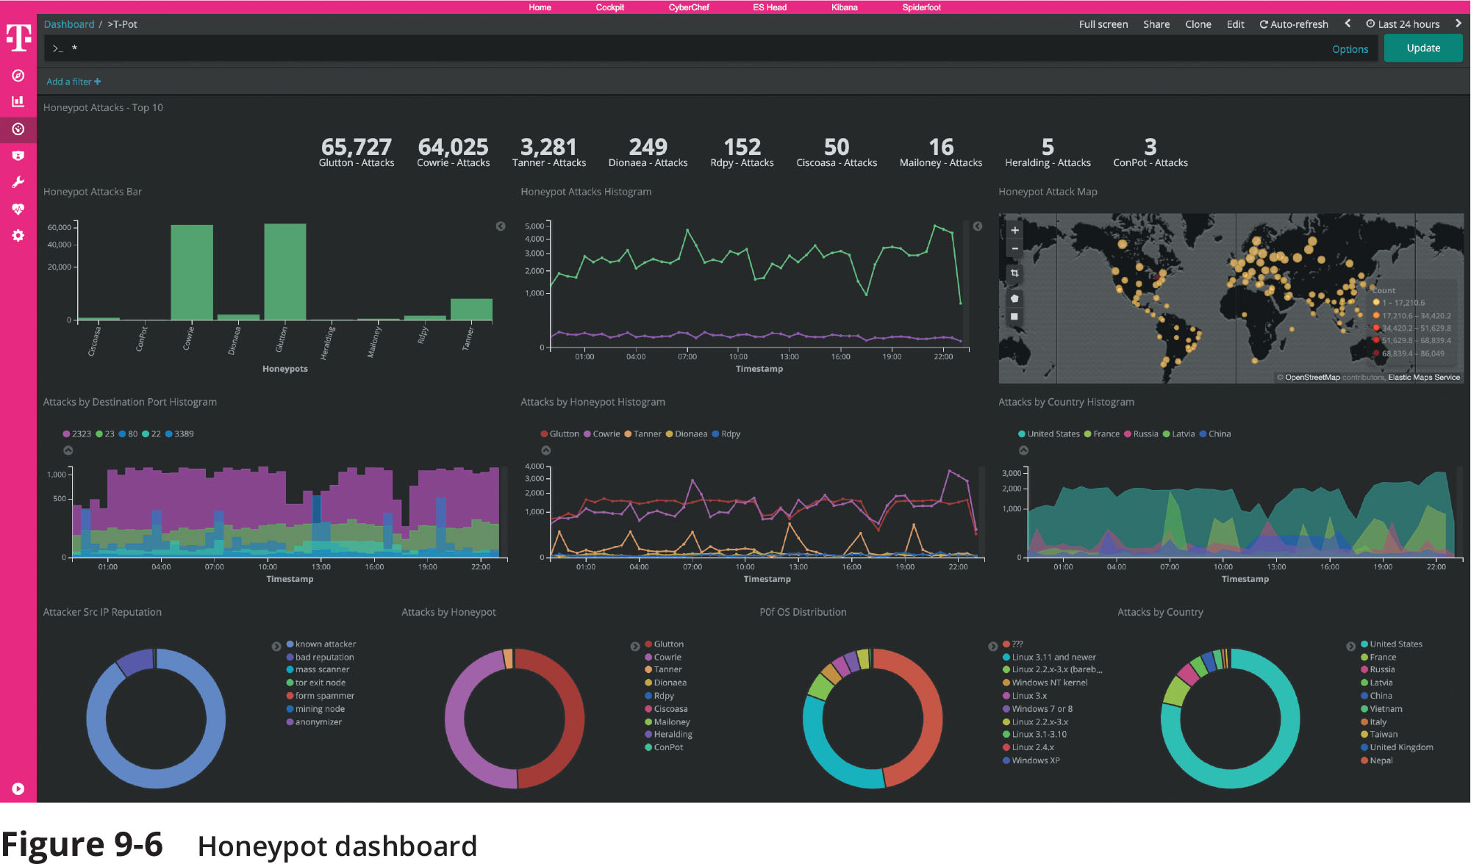
Deception Instruments (2 of 3)
Figure 9-6 Honeypot dashboard

Slide 14
Deception Instruments (3 of 3)
Honeypots (continued)
Different types of honeypots:
A low-interaction honeypot may only contain a login prompt
A high-interaction honeypot is designed for capturing more information from the threat actor
This type of honeypot can collect information from threat actors about attack techniques or the particular information they are seeking from the organization
A honeynet is a network of honeypots set up with intentional vulnerabilities
Sinkholes
A sinkhole is a “bottomless pit” designed to steer unwanted traffic away from its intended destination to another device
The goal is to deceive the threat actor into thinking the attack was successful

Slide 15
Intrusion Detection and Prevention Systems (1 of 3)
An intrusion detection system (IDS) can detect an attack as it occurs
An intrusion prevention system (IPS) attempts to block the attack
Inline system is connected directly to the network and monitors the flow of data as it occurs
A passive system is connected to a port on a switch, which receives a copy of network traffic
IDS systems can be managed in different ways:
In-band management is through the network itself by using network protocols and tools
Out-of-band management is using an independent and dedicated channel to reach the device

Slide 16
Intrusion Detection and Prevention Systems (2 of 3)
Monitoring Methodologies
Anomaly-based monitoring compares current detected behavior with baseline
Signature-based monitoring looks for well-known attack signature patterns
Behavior-based monitoring detects abnormal actions by processes or programs
Alerts user who decides whether to allow or block activity
Heuristic monitoring uses experience-based techniques
Attempts to answer the question “Will this do something harmful if it is allowed to execute?”

Slide 17
Intrusion Detection and Prevention Systems (3 of 3)
A network intrusion detection system (NIDS) watches for attacks on the network
NIDS sensors installed on firewalls and routers gather information and report back to central device
A network intrusion prevention system (NIPS) monitors to detect malicious activities and also attempts to stop them

Slide 18
Network Hardware Security Modules
A hardware security module (HSM) is a removable external cryptographic device
For endpoints, an HSM is typically a USB device, an expansion card, or a device that connects directly to a computer through a port
A network hardware security module performs cryptographic operations such as key management, key exchange, onboard random number generation, key storage facility, and accelerated symmetric and asymmetric encryption

Slide 19
Configuration Management
It is essential that security appliances be properly configured
Basic configuration management tools include:
Secure baseline configurations
Standard naming conventions
Defined Internet Protocol schema
Diagrams

Slide 20
Knowledge Check Activity 1
Which of the following network security devices is a computer that is purposely located in an area with limited security to attract threat actors?
a. Forward proxy
b. Honeypot
c. Inline system
d. Behavior monitor

Slide 21
Knowledge Check Activity 1: Answer
Which of the following network security devices is a computer that is purposely located in an area with limited security to attract threat actors?
Answer: b. Honeypot
A honeypot is a computer located in an area with limited security that serves as “bait” to threat actors. Its purpose is to deflect and discover threats.

Slide 22
Security Technologies
There are general security technologies that can provide a defense
Some of these technologies can be found in both standard networking devices (switches and routers) and specialized security appliances
Categories of security technologies include:
Access technologies
Monitoring and managing technologies
Design technologies

Slide 23
Access Technologies (1 of 7)
Access Control List (ACL)
An access control list (ACL) contains rules that administer the availability of digital assets by granting or denying access to the assets
Two types of ACLS include:
Filesystem ACLs filter access to files and directories on an endpoint by telling the OS who can access the device and what privileges they are allowed
Networking ACLs filter access to a network
Often found on routers
Router ACLs can be used on external routers to restrict vulnerable protocols and limit traffic from entering the network
Internal router ACLs are often configured with explicit allow and deny statements for specific addresses and protocol services

Slide 24
Access Technologies (2 of 7)
Virtual Private Network (VPN)
A VPN is a security technology that enables authorized users to use an unsecured public network (the Internet) as if it were a secure private network
Two common types of VPNs:
A remote access VPN
A site-to-site VPN
A full tunnel sends all traffic to the VPN concentrator and protects it
A split tunnel routes only some traffic over the secure VPN while other traffic directly accesses the Internet (this helps preserve bandwidth)
The most common protocols used for VPNs are IPsec and SSL

Slide 25
Access Technologies (3 of 7)
Network Access Control (NAC)
NAC examines the current state of a system or network device before it can connect to the network
Any device that does not meet a specified set of criteria can connect only to a “quarantine” network where the security deficiencies are corrected
NAC uses software “agents” to gather information and report back (called host agent health checks)
An agent may be a permanent NAC agent or a dissolvable NAC agent that disappears after reporting information to the NAC
The NAC technology can be embedded within a Microsoft Windows Active Directory (AD) domain controller
NAC uses AD to scan the device (called agentless NAC)

Slide 26
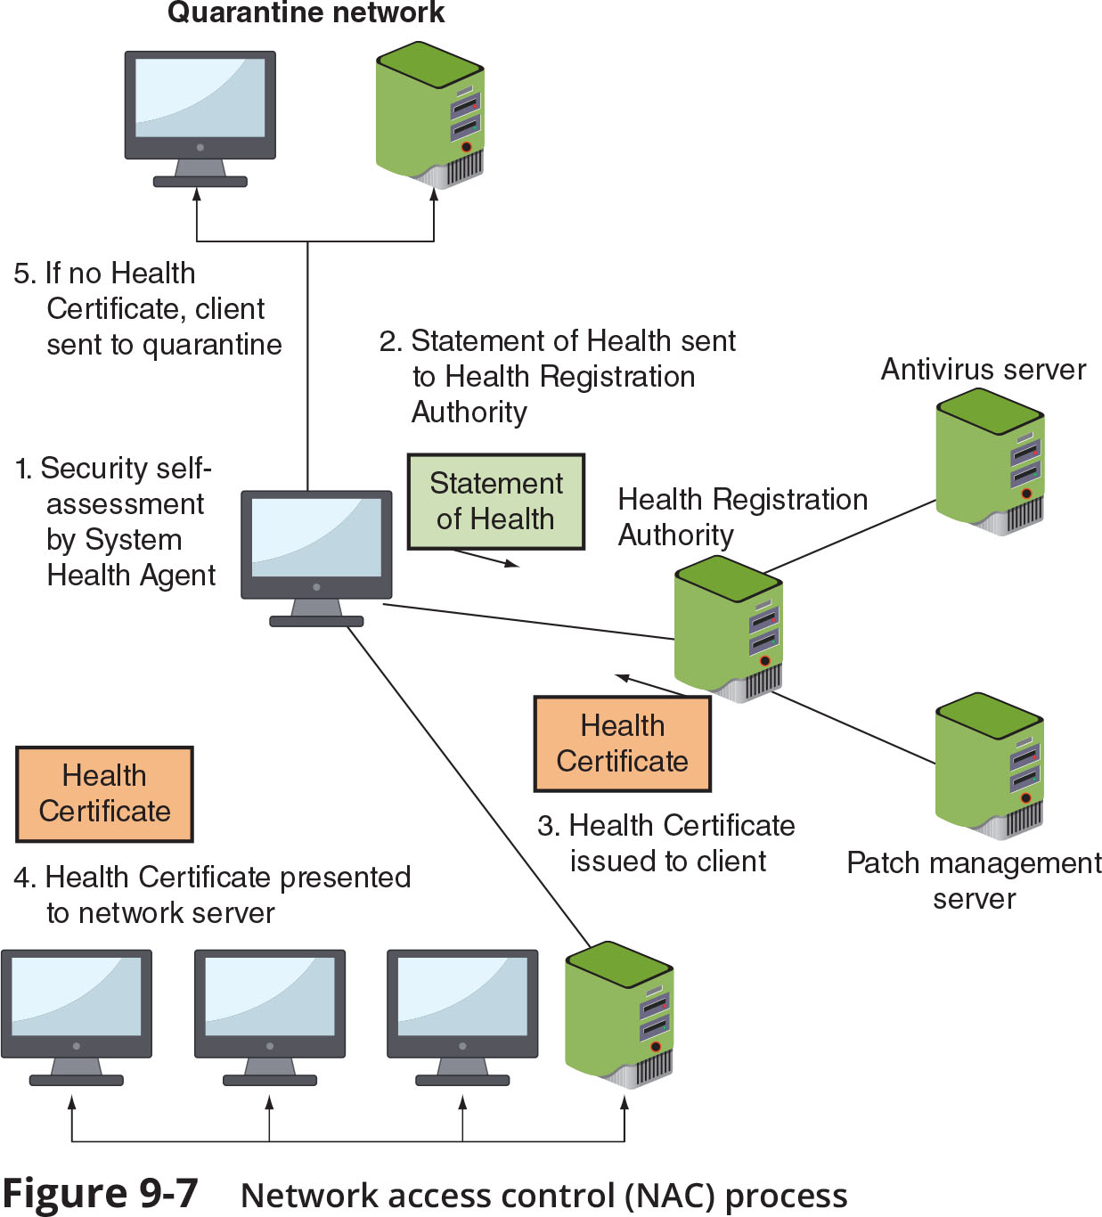
Access Technologies (4 of 7)

Slide 27
Access Technologies (5 of 7)
Data Loss Prevention
DLP is considered as rights management, or the authority of the owner of the data to impose restrictions on its use
DLP is a system of security tools that is used to recognize and identify data that is critical to the organization
Most DLP systems use content inspection which is defined as a security analysis of the transaction within its approved context
An administrator creates DLP rules based on the data and the policy
These rules are loaded into a DLP server
When a policy violation is detected by the DLP agent it is reported back to the DLP server

Slide 28
Access Technologies (6 of 7)
Data Loss Prevention (continued)
When a server is notified of a policy violation different actions can be taken:
Block the data
Redirect it to an individual who can examine the request
Quarantine the data until later
Alert a supervisor of the request
A process called tokenization obfuscates sensitive data elements, such as an account number, into a random string of characters (token)
The original sensitive data element and the token are stored in a database called a token vault so that if the actual data element is needed, it can be retrieved as needed
Tokenization is illustrated in Figure 9-8 on the following slide

Slide 29
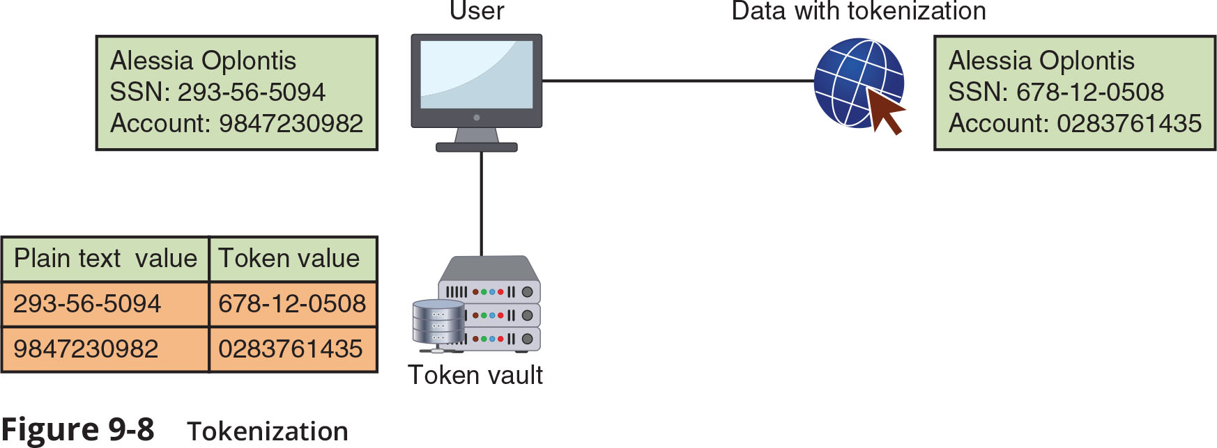
Access Technologies (7 of 7)
Figure 9-8 Tokenization

Slide 30
Technologies for Monitoring and Managing (1 of 6)
Port Security
Threat actors who access a network device through an unprotected port can reconfigure the device to their advantage
Route security is the trust of packets sent through a router
False route information can be injected or altered by weak port security
Broadcast storm prevention can be accomplished by loop prevention
Loop prevention uses the IEEE 802.1d standard spanning-tree protocol (STP)
STP uses an algorithm that creates a hierarchical tree layout that spans the entire network

Slide 31
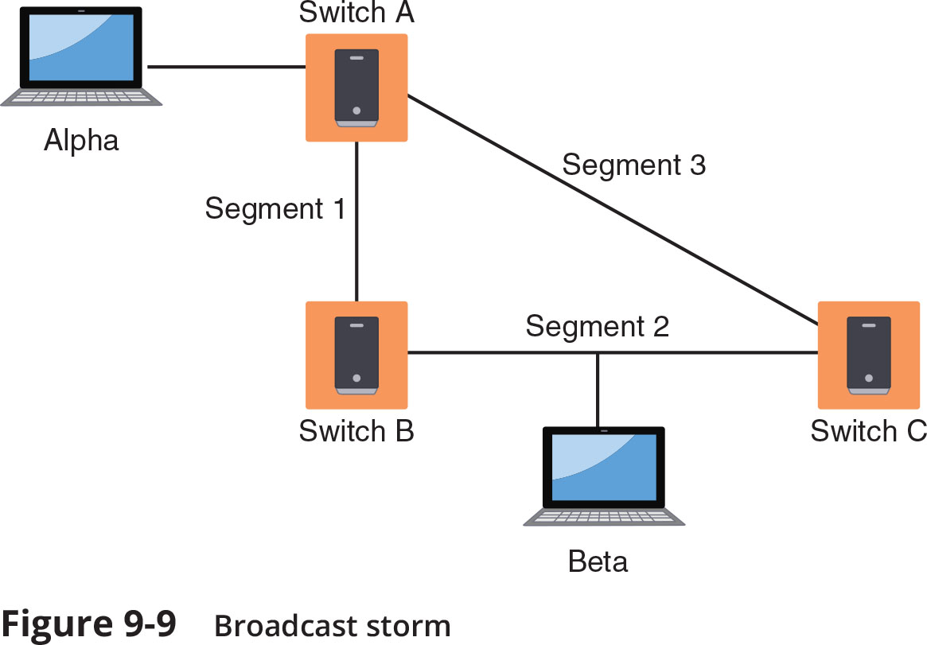
Technologies for Monitoring and Managing (2 of 6)
Figure 9-9 Broadcast storm

Slide 32
Technologies for Monitoring and Managing (3 of 6)
Packet Capture and Analysis
Analyzing packets helps to monitor network performance and reveal cybersecurity incidents
Monitoring traffic on switches can be done in two ways:
A separate port TAP (test access point) can be installed
Port mirroring (also called port spanning) allows the administrator to configure the switch to copy traffic on some or all ports to a designated monitoring port on the switch
Monitoring Services
An external third-party monitoring service can be used to provide additional resources to assist an organization in its cybersecurity defenses

Slide 33
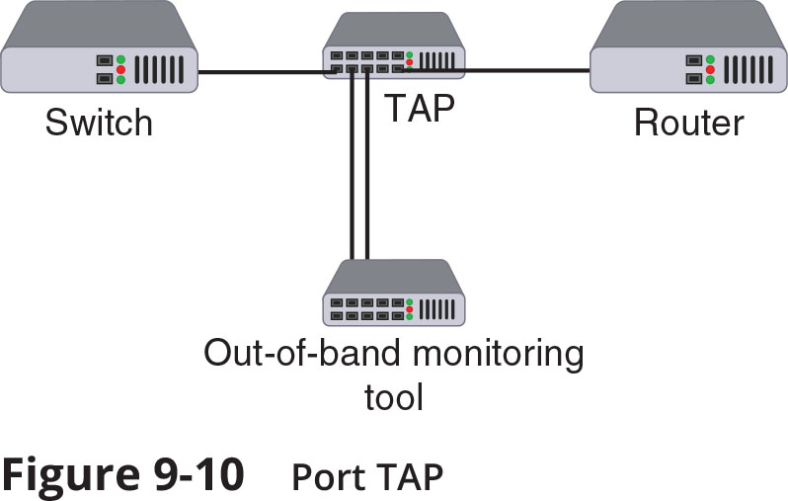
Technologies for Monitoring and Managing (4 of 6)
Figure 9-10 Port TAP

Slide 34
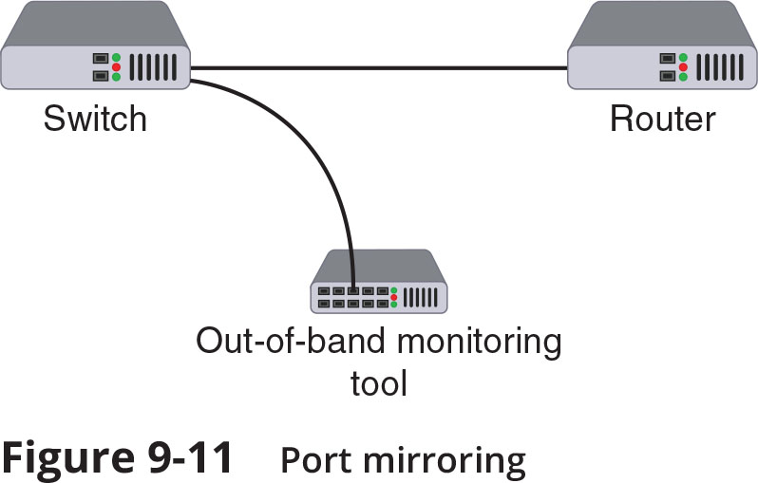
Technologies for Monitoring and Managing (5 of 6)
Figure 9-11 Port Mirroring

Slide 35
Technologies for Monitoring and Managing (6 of 6)
File Integrity Monitors
File integrity monitors examine files to see if they have changed
File integrity monitors are used for detecting malware as well as maintaining compliance with industry-specific regulations
Quality of Service (QoS)
QoS is a set of network technologies used to guarantee its ability to dependably serve network resources and high-priority applications to endpoints
A network administrator can assign the order in which packets are handled and the amount of bandwidth given to an application or traffic flow (called traffic shaping)
Almost all firewalls today recognize QoS settings

Slide 36
Design Technologies (1 of 7)
Network Segmentation
Examples of network segmentation include virtual LANs and a demilitarized zone
Zero trust is a strategic initiative about networks that is designed to prevent successful attacks
It attempts to eliminate the concept of trust from an organization’s network architecture
Zero trust requires that networks be segmented
A network can be segmented by separating devices into logical groups by creating a virtual LAN (VLAN)
VLANs can be isolated so that sensitive data is transported only to members of the VLAN

Slide 37
Design Technologies (2 of 7)
Network Segmentation (continued)
A demilitarized zone (DMZ) is a separate network located outside secure network perimeter
Untrusted outside users can access DMZ but cannot enter the secure network
A common approach to configuring a DMZ is to use a jump box (sometimes called a jump server or jump host)
A jump box is a minimally configured administrator server that connects two dissimilar security zones while providing tightly restricted access between them

Slide 38
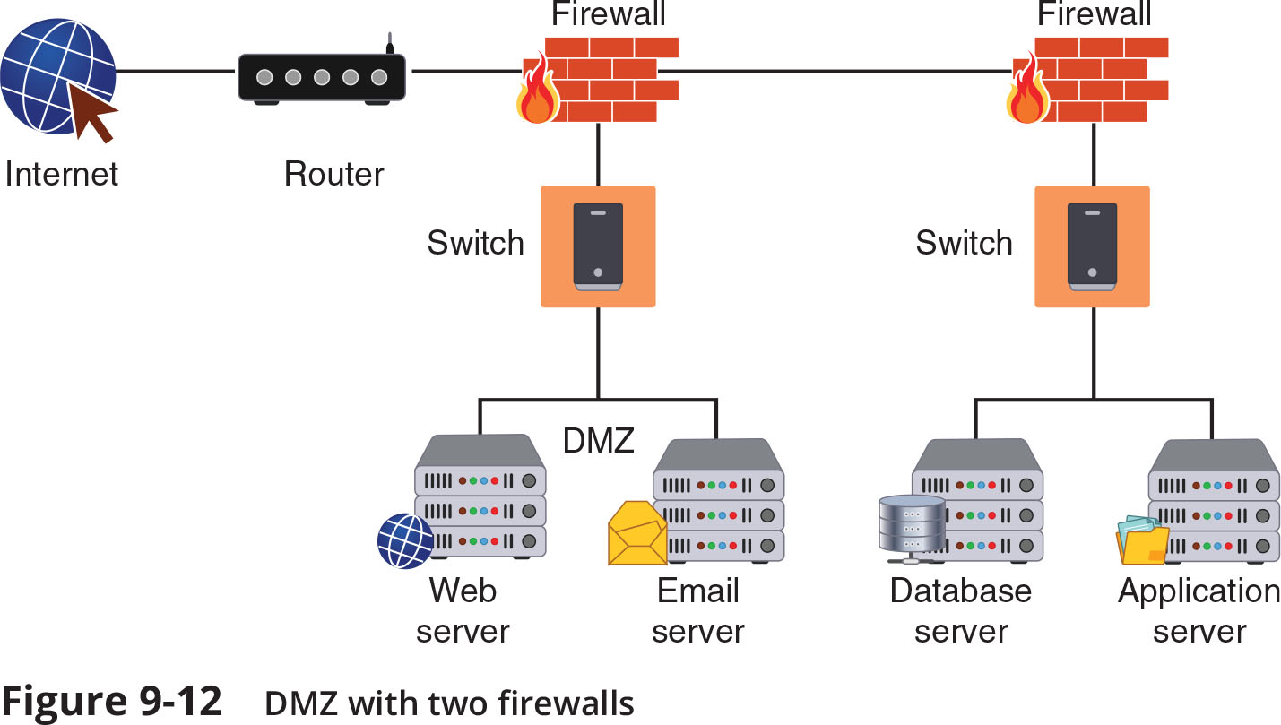
Design Technologies (3 of 7)

Slide 39
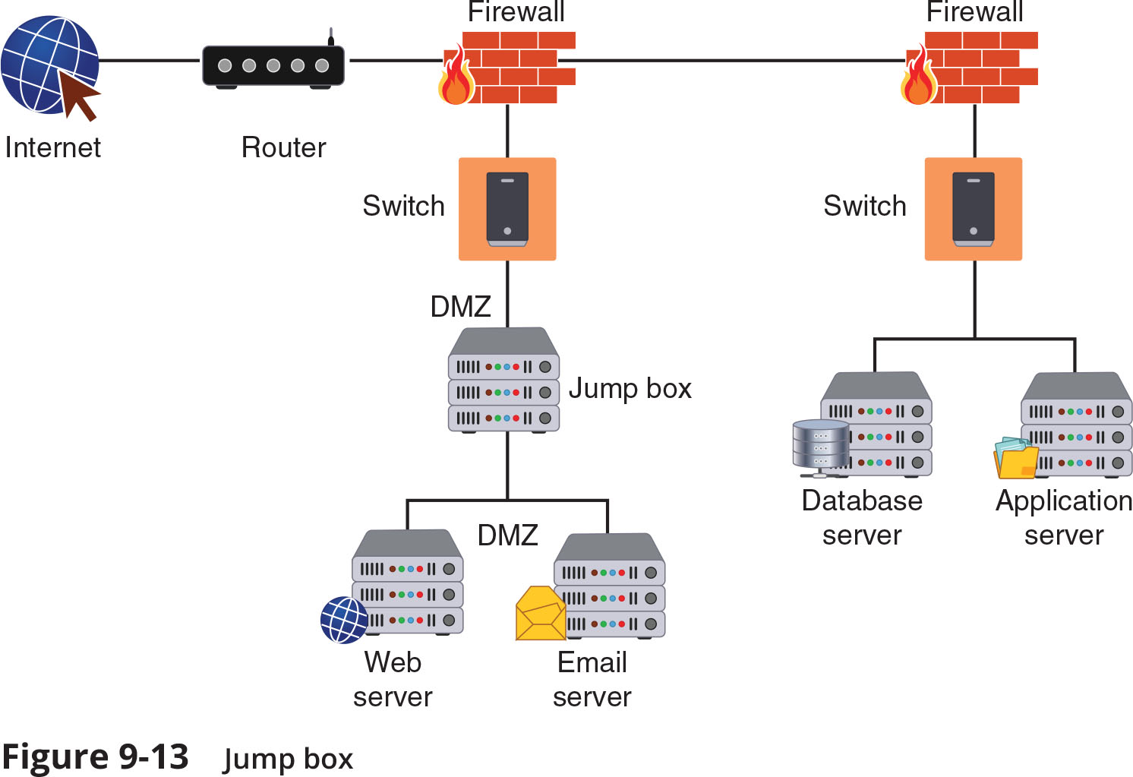
Design Technologies (4 of 7)

Slide 40
Design Technologies (5 of 7)
Load Balancing
Load balancing is a technology that can help to evenly distribute work across a network and can allocate requests among multiple devices
Advantages of load-balancing technology:
Reduces probability of overloading a single server
Optimizes bandwidth of network computers
Load balancing is achieved through software or hardware device (load balancer)
Different scheduling protocols used in load balancers:
Round-robin
Affinity

Slide 41
Design Technologies (6 of 7)
Load Balancing (continued)
When multiple load balancers are used together, they can be placed in different configurations that include:
In an active-passive configuration, the primary load balancer distributes the network traffic to the most suitable server, while the secondary load balancer operates in a “listening mode”
In an active-active configuration, all load balancers are always active
Load balancing can also support session persistence, which is a process in which a load balancer creates a link between an endpoint and a specific network server for the duration of a session
This can help improve the user experience and optimize network resource usage

Slide 42
Design Technologies (7 of 7)
Load Balancing (continued)
Security advantages of using a load balancer:
They can detect and stop attacks directed at a server or application
Can also detect and prevent protocol attacks
Some load balancers can hide HTTP error pages or remove server identification headers from HTTP responses, denying attackers additional information about the internal network

Slide 43
Knowledge Check Activity 2
What type of access technology routes some traffic over a secure VPN while other traffic accesses the Internet directly without going through the VPN?
a. Split tunnel
b. Site-site VPN
c. Router ACL
d. Full tunnel

Slide 44
Knowledge Check Activity 2: Answer
What type of access technology routes some traffic over a secure VPN while other traffic accesses the Internet directly without going through the VPN?
Answer: a. Split tunnel
A split tunnel routes only some traffic over the secure VPN while other traffic directly accesses the Internet (this helps preserve bandwidth).

Slide 45
Self-Assessment
Consider the network security appliances and technologies you have studied in this module. Based on what you know now, if you could pick only one network security appliance and one security technology you could deploy on a network you were managing, which would they be and why?

Slide 46
Summary (1 of 2)
A computer firewall is designed to limit the spread of malware
Stateless packet filtering on a firewall looks at a packet and permits or denies it based solely on the firewall rules
Stateful packet filtering uses both the firewall rules and the state of the connection
There are several specialized firewall appliances: a web application firewall (WAF), a next generation firewall (NGFW), unified threat management (UTM) device
A forward proxy is a computer or program that intercepts user requests from the internal network and processes these requests on behalf of the user
A honeypot is a computer located in an area with limited security that serves as “bait” to threat actors
An intrusion detection system (IDS) can detect an attack as it occurs, an intrusion prevention system (IPS) attempts to block the attack

Slide 47
Summary (2 of 2)
A network hardware security module is a special trusted network computer that performs cryptographic operations such as key management, key exchange, onboard random number generation, key storage facility, and symmetric and asymmetric encryption
An access control list (ACL) contains rules that administer the availability of digital assets by granting or denying access to the assets
Network access control (NAC) examines the current state of an endpoint before it can connect to the network
Data loss prevention (DLP) is a system of security tools used to recognize and identify data critical to the organization and ensure that it is protected
Broadcast storm prevention can be accomplished by loop prevention, which uses the IEEE 802.1d standard spanning-tree protocol (STP)

